Slide 1
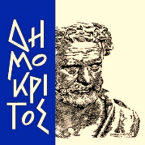
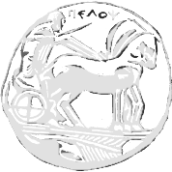
Using gan to generate fake pokemon
NATIONAL CENTER FOR SCIENTIFIC RESEARCH “DEMOKRITOS”
JOHN PAPADOPOULOS (dit2216dsc)
LEONIDAS XEROVASSILAS (dit2223dsc)
UNIVERSITY OF THE PELOPONNESE

Slide 2
INTRODUCTION
The purpose of this project is the creation of a GAN with python and torch that generates fake pokemon.

Slide 3
WHAT IS A GAN ANYWAY?
A Generative Adversarial Network or GAN is is a deep neural network framework that is consisted of two distinct neural networks. The Generator and the Discriminator
The Generator learns to transform noise into new data that are indistinguishable in form from the original data.
The Discriminator learns to discriminate between original data (which accepts as input) and fake data and punishes the generator for producing implausible data.

Slide 4
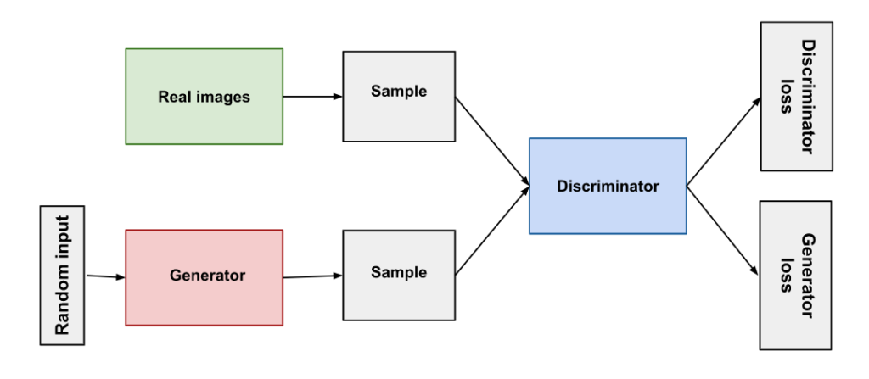
STRUCTURE OF A GAN

Slide 5
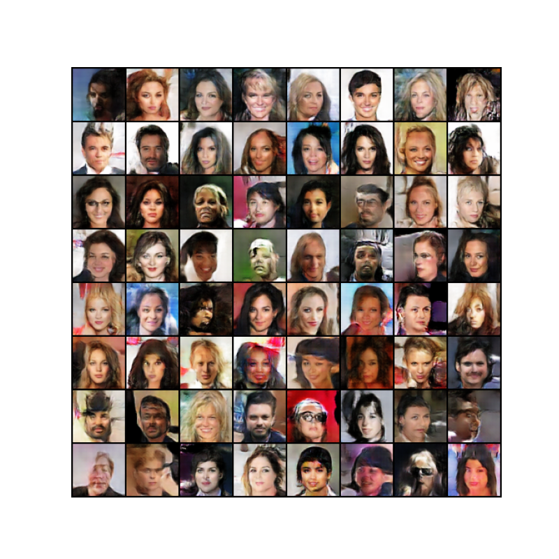
BASIS OF OUR MODEL
Our model is based upon a python based example GAN made with torch for generating fake celebrities. (DCGAN Tutorial — PyTorch Tutorials)
Its results are presented below.

Slide 6
DETAILS OF OUR MODEL
Our model uses a 13 layer generator coupled with a 12 layer discriminator.
Most of the model’s hyperparameters are user tunable but the default ones are for now the ones that produce the best result in the shortest possible time.
By default the generator as well as the discriminator use 64x64 resized images with 3 channels (color images) and 48 feature maps
For the optimization function the Adam function with beta function with a=0.5 and b=0.999 and learning rate of 0.00002 is used.

Slide 7
THE GENERATOR
The generator consists of multiple layers of two dimensional transported convolution followed by batch normalization and ReLU or softmax filters.
Each convolution layer takes the output channels of the previous one as input and with each convolution the channels are reduced starting from the latent vector and reaching 3 channels (the channels that represent a color image).

Slide 8
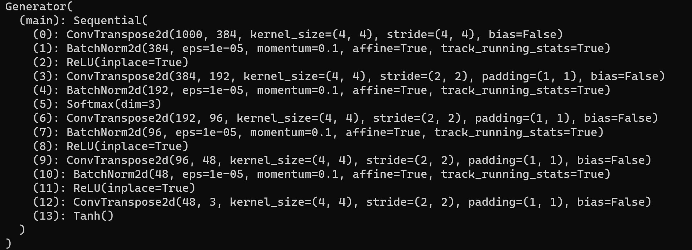
THE GENERATOR (2)

Slide 9
THE DISCRIMINATOR
The discriminator consists of multiple layers of two dimensional convolution followed by batch normalization and leaky ReLU filters.
Each convolution layer takes the output channels of the previous one as input and with each convolution but contrary to the generator channels are increased starting from 3 channels (the channels that represent a color image) and reaching 348 before the last convolution that fall to one channel for the discrimination purposes.

Slide 10
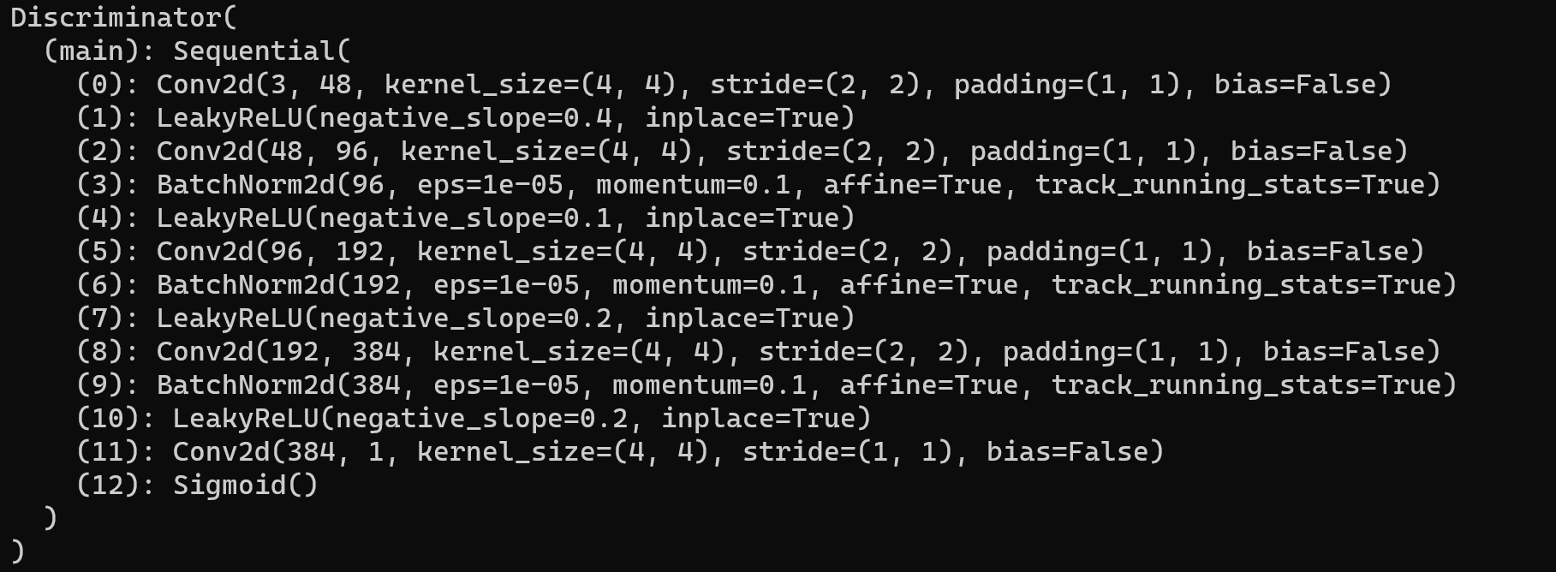
THE DISCRIMINATOR (2)

Slide 11
RUNNING THE PROGRAM
In order to run the program in any platform installation of python 3 >=3.8 is required. Apart from python itself a series of requirements must also be installed in order for the program to run successfully.
torch==2.0.1
torchvision==0.15.2
matplotlib==3.7.1
matplotlib-inline==0.1.6
numpy==1.25.0
ipython==8.14.0
argparse==1.4.0
The python program can run with cpu or gpu acceleration and the best method is automatically selected.

Slide 12
RESULTS
The best result is given after training the program for approximately 500 epochs.
The graph of generator and discriminator losses and the final result of the program are given in the next slides

Slide 13
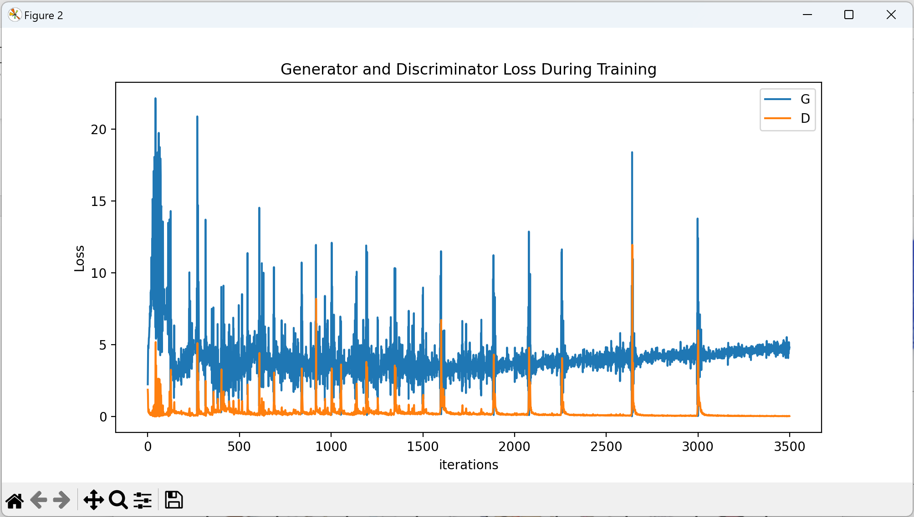
RESULTS (2)

Slide 14
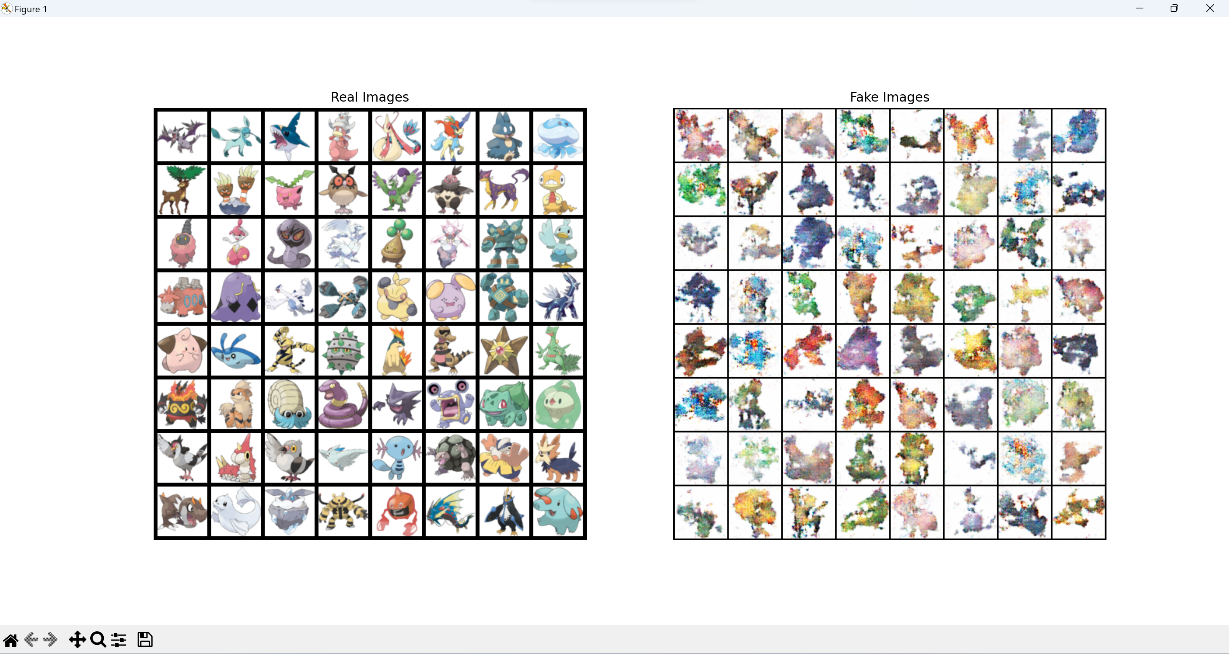
RESULTS (3)

Slide 15
THE END
Thank you for your consideration

